Slide 1



Supply Chain management . Comparison of the use of I.T. in
AND
Vinay Kumar (C17474442) and Niall Murphy (C17313343)
Mathew Tompkins (C17491594) and Enda Linehan (C17330683)

Slide 2
Table of Contents
Introduction
DVL → Mathew Tomkins - C17491594
Brown Thomas → Enda Lineman - C17330683
Customer Service
DVL → Mathew Tomkins - C17491594
Brown Thomas → Enda Lineman - C17330683
Warehousing
DVL → Vinay Kumar – C174744442
Brown Thomas → Niall Murphy - C17313343
Manufacturing
DVL → Vinay Kumar – C174744442
Brown Thomas → Niall Murphy - C17313343
Use of IT in Distribution
DVL → Mathew Tomkins - C17491594
Brown Thomas → Enda Lineman - C17330683
Competitive Strengths
DVL → Vinay Kumar – C174744442
Brown Thomas → Niall Murphy - C17313343

Slide 3
Introduction

Slide 4
Introduction into Brown Thomas
Brown Thomas identifies itself as a reliable icon of grace and good taste it is a name that is synonymous with luxury, integrity and beauty.
Brown Thomas was founded in 1849 by Hugh Brown, a haberdasher, and James Thomas, a draper.
In 1919 Brown Thomas changed hands: Harry Gordon Selfridge, the legendary American bought the Store and brought Brown Thomas into the 20th Century.
In 1919 Harry Gordon an American entrepreneur and brought the thriving store into the 20th Century

Slide 5
In 1933 it changed hands again to an Irishman called John McGuire.
In 1971 almost a century after Brown Thomas was founded Gary and Hilary Weston bought the premises on Grafton Street and began to transform it so it could rival some of the best in the world.
Brown Thomas has over 1050 employees covering Dublin Limerick Galway and /cork
The company has sectors in luxury fashion, homeware and food sector.

Slide 6
Brown Thomas has directed itself to be “a retail experience that was stylish, sophisticated and brimming with flair.”
The issues that could effect this companies success could be weather or when the Grafton store closed in 2016.

Slide 7
Customer Service

Slide 8
Brown Thomas Customer Service
Brown Thomas offers a loyalty card programme, has multiple seasonal sales and has a large social media profile on Facebook, Twitter Instagram and Pinterest.
Online website is easy to use and is clear for customers to find what they need.
They give customers the option to deliver fast deliver and “click and collect”.
Brown Thomas has many methods of returning damaged or wrong products a customer may go into the store, go online or call customer services.

Slide 9
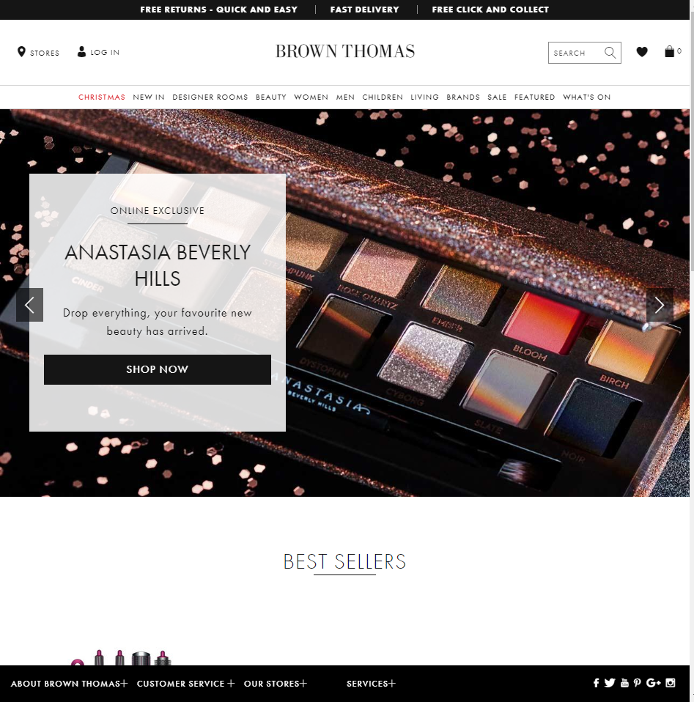

Slide 10
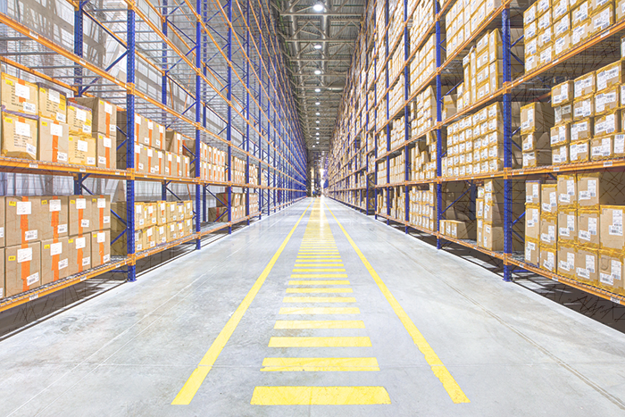
Warehousing
Location
Two prime locations (Motorway Access and Nationwide delivery services)
Warehouses in Blanchardstown (Wines) and Swords (Beers & Spirits) (1)
Spatial Limitations
Growth of 22% annually for period of 5 years. (2)
Outgrew original premises in Ballycoolin.
Renting 2nd warehouse that is never at full capacity until the Christmas period. (3)
Main Activities and Use of IT
Receiving, warehousing and distribution of client’s stock (4)
IT used throughout to arrange bookings for incoming stock, to receive, create and process orders
System used – Vintners Enterprise (5) ( now outdated, compatibility issues with Microsoft not efficient for high order volumes)
Automated Machinery used in the warehouse. Power pallet trucks, forklifts, AGV’s (6) and climber machines.
Level of Automation in picking and storage
No automation used physically in picking “not feasible”(7) and “too expensive”(8)
Machinery equipment used to aid the process. No automation in storage as warehouses are cold and dry, lack of light ( Conditions for wines & beers) (9)

Slide 11
Warehousing
Location
Onsite Warehouse located warehouse under shop on Grafton street. (1)
Online dept. is shared with store’s warehouse, often can’t handle high volume of orders.
Warehouse space located near Dublin airport (Motorway access), where stock is held and order fulfilment is carried out.(1)
Spatial limitations
Store shares its online department with onsite warehouse on Grafton street.
Can often not handle high volume of orders, second warehouse exists to combat this.
Main Activities and Use of IT
Screamer tags for high-value goods.
Swipe card access for certain high-value items.
Electric pallet trucks, fork-lift.
Hand-held scanners for new incoming stock. all (1)
Level of automation in picking and storage
Orders orders checked out through guns and scanners but controlled by humans

Slide 12
Warehousing
Stock rotation and IT - Wine, Gin, Tonic Water
Stock monitored by the system . Expensive wines usually have the longest housing time.
Slow moving, expensive stock that is not performing can be held for long periods of time. Stock is recorded manually on the system as it comes into the warehouse. As orders come in, stock is allocated until the order has been confirmed and invoiced. Then the stock is decreased on the system. (11)
Examples of product rotation are:
Wine – Whispering Angel Rosé, 1-2 pallets (70 cases per pallet) sold in one day. Replenished every 2 months. (12)
Gin – Blackwater Distillery, When in demand stock sells out in 2-3 days, stock replenished within 1 week. (13)
Tonic Water – Poachers Well Wild Tonic, Usually purchased with Gin, Stock replenished within 1 week. (13)
Order Picking
Completed by warehouse Operatives. Collect order dockets from the office. Product pick sheet show products quantity and location. Products are then picked manually using machinery if products are in high bays. No IT directly involved in the process which leaves room for human error. Averaging 20 miss-picks a week. DVL cover cost of miss-picks (redistribution of stock). (15)
Cost of warehousing
Costs includes rent (below the normal price of 50k per year) (16), utility bills, maintenance, electricity and rent on machinery. Upkeep fee for the area is €4000 per year. (17)

Slide 13
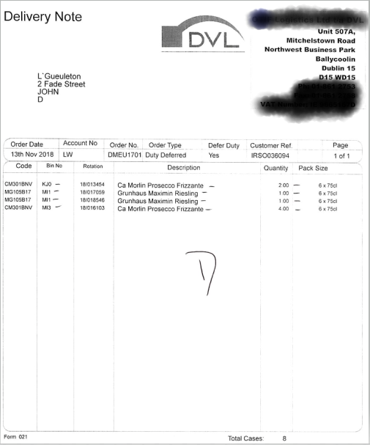
DVL – Pick Sheet ‘Picking Sheet, DVL Client Clearences/Deliveries – Vintners Enterprise’, Screenshot, accessed 13th November 2018 by Vinay Kumar.

Slide 14
Warehousing
Stock rotation and IT
Christmas shop stock- Stock available instore and online from august each year.(2)
Yeezys limited to 1 pair/customer due to demand(3), waiting list to pre-order. Expected to sell out within 12 hours.(4)
Designer handbags- high demand when on sale, one of Brown Thomas’ best sellers(5)
Order Picking
Orders come through on EDI, imported in. Orders printed on picking sheets and organized by departments.(6)
Pick sheet shows the product and their quantity. (7)
Handheld device to scan product barcode limits incorrect order picking, so customer will always receive correct product(8)
Cost of warehousing
Discounts usually given due to bulk buying(9)

Slide 15
Warehousing References – Vinay Kumar
1→ ‘Northwest Logistics Park. Ballycoolin, Blanchardstown, Dublin 15’. In Savills Corporate website.
Retrieved from: http://search.savills.ie/Properties/Commercial/Industrial/Northwest-Business-Park-sites.aspx
2 → Interview with Liam Meaney, Chairman on 25th October 2018.
3 → Interview with Mark Lambe, Managing Director/Operations Manger on 26th October 2018.
4 → Lambe, M. LinkedIn [LinkedIn Profile]
Retrieved from: https://ie.linkedin.com/in/mark-lambe-765b5617
5→ ‘The Computer System for Drinks Trade Wholesalers and Importers’. In Vintner’s Corporate website.
Retrieved from: http://www.vintner.co.uk/
6 → Automated Guided Vehicles (AGV’s). In AGV’s Corporate Website.
Retrieved from: http://www.davcon.eu/index.php/products/automated-guided-vehicles
7 → Interview with Liam Meaney, Chairman on 25th October 2018.
8 → Interview with Mark Lambe, Managing Director/Operations Manger on 26th October 2018.
9 → Interview with Mark Lambe, Managing Director/Operations Manger on 26th October 2018.
10 → Search Property For Sale and Rent in Dublin’. In Daft.ie’s Corporate website.
Retrieved From: https://www.daft.ie/dublin/commercial-property-for-rent/industrial-unit-for-rent/
11 → Interview with Mark Lambe, Managing Director/ Operations Manger on 26th October 2018.
12 → ‘WineOnline.ie From the vine to your home - Whispering Angel Rosé’. In WineOnline.ie’s Corporate website.
Retrieved from: https://wineonline.ie/collections/whispering-angel-rose
13 → ‘GreatIrishBeverages.com brand- poachers Irish Tonic Water’ In GreatIrishBeverages.com’s Corporate website.
Retrieved from: http://www.greatirishbeverages.com/brand/poachers-wild-irish-tonic-water/
14 → ‘Blackwaterdistillery.ie - gin’ In Blackwaterdistillery.ie Corporate website. Retrieved from: http://blackwaterdistillery.ie/ 15 → Interview with Mark Lambe, Managing Director/Operations Manger on 26th October 2018.
16 → Interview with Fergus O’Rafferty, Finance Director on 22nd October 2018.
17 → Interview with Mark Lambe, Managing Director/Operations Manger on 26th October 2018.

Slide 16
Warehousing References – Niall Murphy
1→ Interview with Anthony Molloy, Online MultiChannel manager, conducted by Vinay Kumar and Niall Murphy, November 5th 2018
2→ Christmas Shop opening in August article from the journal - https://www.thejournal.ie/brown-thomas-christmas-shop-dublin-4184174-Aug2018/
3→ Yeezy drop https://www.dublinlive.ie/lifestyle/fashion-and-beauty/dublins-brown-thomas-selling-yeezy-14873572
4→ Yeezy drop https://www.brownthomas.com/be-inspired-style-features/yeezy-ballot/
5→ Handbags https://www.irishexaminer.com/lifestyle/features/appetites-for-designer-handbags-hold-on-as-most-expensive-arm-candy-sold-this-year-373106.html
6→ Interview with Anthony Molloy, Online MultiChannel manager, conducted by Vinay Kumar and Niall Murphy, November 5th 2018
7→ Interview with Anthony Molloy, Online MultiChannel manager, conducted by Vinay Kumar and Niall Murphy, November 5th 2018
8→ Interview with Anthony Molloy, Online MultiChannel manager, conducted by Vinay Kumar and Niall Murphy, November 5th 2018
9→ Interview with Anthony Molloy, Online MultiChannel manager, conducted by Vinay Kumar and Niall Murphy, November 5th 2018

Slide 17
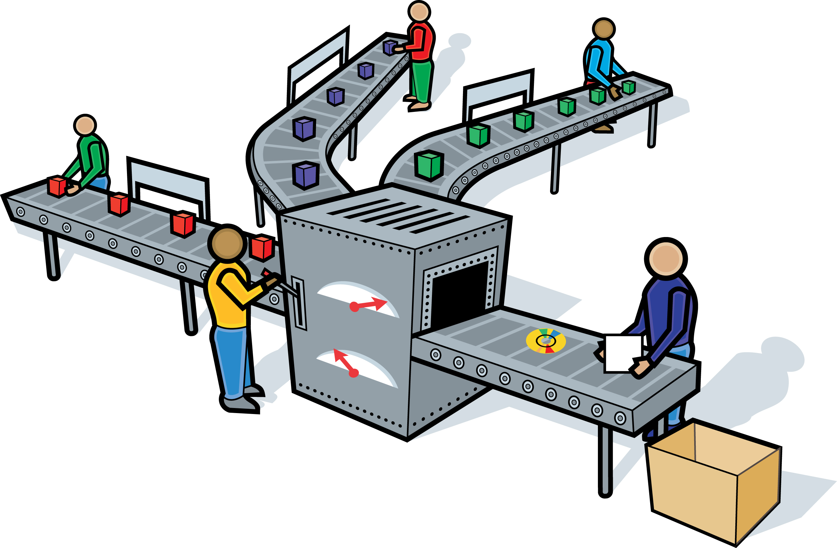
Manufacturing
Use of IT in product design/concept
Provide customer service with high levels of customer satisfaction. “Focused on delivering premium quality service and standards, and are customer driven.” (1)
Concept - “Take the worry of receiving, housing and distribution away from our clients” (2)
To fulfil this concept DVL rely on their IT system – Vintners Enterprise System (3) to receive and mange client stock, to fulfil orders and to generate invoices and required customs documentation for duty payments. (4)
Use of IT in manufacturing /Purchasing
DVL do not produce or manufacture goods.
Purchasing – Most transactions made over the phone for equipment or necessities. Orders made for office supplies are done by email and by phone.
Company account with Lyreco (5)
Quality of system used and IT (Vitners)
Vinters “tailored specifically” (6) for the food and drink industry – “Stock control, EPOS,EDI) (7), management reporting, multi- currency accounting, duty management, customer reserves and more.” (8)
Quality - Outgrown software at a constant rate without the system being updated. Effectiveness and efficiency is limited. Compatibility issues with Microsoft applications. Methods of order processing leave a lot of room for human error in the processing stage(manifesting, labelling, incorrect data entry) and the picking stage (20 miss-picks/week). Stock can even go into minus figures on the system (-1). Human errors 'frequent – wrong products sent, incorrect quantities added to system, incorrect stock locations, products sent to wrong address or sent with the wrong delivery provider.

Slide 18
Manufacturing
Use of IT in product design
Company has no set product to manufacture, but has an up-to-date, user-friendly website.
Customers can log in and track their orders.(1)
Website offers click & collect feature and online newsletter.
Use of IT in manufacturing/purchasing & Quality system used
Purchases made through accounts with customers.(2)
Screamer tags for high-value goods.
Quality system used
Store to invest €25m in online department due to high demand.(3)
Result of increase in online sales- online dept. on track to account for 25% of sales in the next 3 years.
New website design and new software for order fulfilment.(3)
Use ’metastorm’ software.(4)
Screamer tags for high-value goods.

Slide 19
Manufacturing
Tracking within the production and/or packaging process
No specific tracking in place. Tracked by warehouse operatives memory. Country orders are manifested. Up to office staff to spot errors. Then “responsibility is on warehouse personnel to spot discrepancies any manifests or errors made with the orders”. (9)
Service provision and IT
Clients use Vintner’s integrated EDI (Electronic Data Interchange). Enables client to place orders, see stock locations and quantities. (10)
Limited – can’t adjust stock codes, locations, quantities or amend errors. All amendments can only be done by admin (2 people). Any discrepancies, requests, order changes or queries are made by phone or email. Very time consuming and a drawn out process on both ends (Physical stock checks, order changes, cancelled orders etc.) (11)
No integrated system for providers(shipping/hauling companies) of client’s stock. All stock received requires customs, clients and travel documents upon entering the warehouse. Need to book in stock, made by email & phone (causes cultural differences/difficulties). On average 150-200 pallets come received per week( 50-70cases/plt). During busy periods i/e Christmas & summer 200-300 pallets. Causes high pressure time constraints. (12)
Order fulfilment
Employ five external hauling companies to collect country orders from both locations. Orders brought to haulers depot, broken down for delivery and then delivered to their destination. Different haulers cater for different regions, all orders are manifested. A copy is kept on file, another copy is signed by the driver of the hauling company. Once signed, driver loads the stock and it no longer is the responsibility of DVL. Clients must contact haulers for order updates. Rely on hauliers collection reports to locate and confirm order status for clients. (13)
OTIF – DVL’s own courier company (14) (On Time In Full), carries out and completes all orders for Dublin. Certain clients organise the provision of their own delivery drivers for their respective Dublin and country orders. (15)

Slide 20
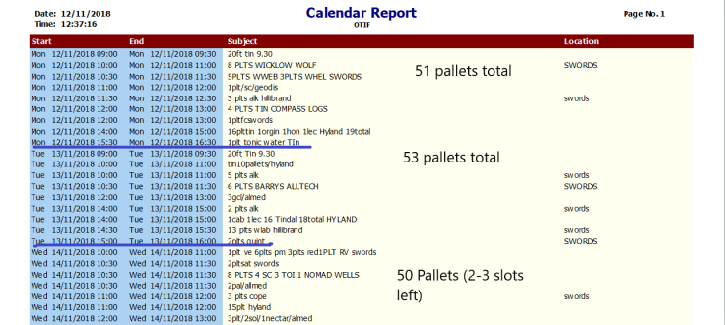
Goods Inwards 12th – 14th Novemebr 2018
Goods Inward report, DVL Calender – Vintners Enterprise, Screenshot, accessed 12th November 2018 by Vinay Kumar. (16)

Slide 21
Manufacturing
Tracking/Use of IT in packaging process
Packaging process: System prints off invoice with order and customer details and shipping label (provided by an Post).(5)
Orders tracked by the system, once scanned in on the guns the order is picked and confirmed on the system and placed with a packing area with its order docket (contains all information on the order, docket scanned by barcode to bring up order details on system, then processed).(6)
Service provision & IT
Online services offer loyalty programmes and rewards.(7)
Helpful service is provided like email updates and convenient delivery.
Order fulfilment
Brown Thomas offer website ordering (with an Post).(8)
An Post service is used for tracking orders.(9)
Click & collect service- customers order specific items then receive a printable notice when the items are ready for collection.(10)
Payment is taken when order is delivered to chosen store destination.
Customer service opening hours align with shop opening hours, there are also phone, email and post services for this to ensure customers are not disappointed.(11)
There is a loyalty line for BT loyalty customers.(12)

Slide 22
Manufacturing References – Vinay Kumar
1→ ‘DVL The Irish Bonded Warehouse of choice - Services’. In DVL’s Corporate website.
Retrieved from: http://dvl.ie/
2 → Interview with Mark Lambe, Managing Director/Operations Manger on 26th October 2018.
3 → ‘The Computer System for Drinks Trade Wholesalers and Importers’. In Vintner’s Corporate website
Retrieved from: http://www.vintner.co.uk/
4 →‘Citizens Information - Excise duties’. In Citizensinformation.ie’s Corporate website.
Retrieved from: http://www.citizensinformation.ie/en/money_and_tax/tax/duties_and_vat/excise_duties.html
5 →‘Lyreco - Office and Work Solutions’. In Lyreco’s Corporate Website.
Retrieved from: https://www.lyreco.com/webshop/ENIR/index.html
6 →’Tailored Specifically’. In Vintner’s Corporate website
Retrieved from: http://www.vintner.co.uk/
7 → ‘Union Pacific - Building America - What is Electronic Data Interchange (EDI)?’. In Union Pacific’s Corporate Website.
Retrieved from: https://www.up.com/suppliers/order_inv/edi/what_is_edi/
8 → In Vintner’s Corporate website. Retrieved from: http://www.vintner.co.uk/
9 → Interview with Mark Lambe, Managing Director/Operations Manger on 26th October 2018.
10→ Interview with Liam Meaney, Chairman on 25th October 2018.
11 → Interview with Liam Meaney, Chairman on 25th October 2018.
12 → Interview with Mark Lambe, Managing Director/Operations Manger on 26th October 2018.
13 → Interview with Mark Lambe, Managing Director/Operations Manger on 26th October 2018.
14 → ‘SoloCheck.ie - Otif Logistics Limited’. In SoloCheck.ie’s Corporate Website
Retreived from: https://www.solocheck.ie/Irish-Company/Otif-Logistics-Limited-435653
15 → Interview with Liam Meaney, Chairman on 25th October 2018.
16 → ‘Goods Inward report', DVL Calender – Vintners Enterprise, Screenshot, accessed 12th November 2018 by Vinay Kumar.

Slide 23
Manufacturing References – Niall Murphy
1→Customer order tracking https://www.brownthomas.com/customer-service/tracking-your-order.html
2 → Customer accounts https://www.brownthomas.com/login/?original=%2Faccount%2F
3 →Online investment https://www.independent.ie/business/irish/brown-thomas-and-arnotts-invest-25m-in-online-as-sales-rise-37391727.html
4 → Interview with Anthony Molloy, Online MultiChannel manager conducted on 5th November by Vinay Kumar and Niall Murphy
5 → Interview with Anthony Molloy, Online MultiChannel manager conducted on 5th November by Vinay Kumar and Niall Murphy
6 → Interview with Anthony Molloy, Online MultiChannel manager conducted on 5th November by Vinay Kumar and Niall Murphy
7 → Loyalty programme https://www.brownthomas.com/services/brown-thomas-loyalty-card.html
8 → ”Our standard delivery service is provided by An Post” https://www.brownthomas.com/customer-service/dispatch-and-delivery.html
9 → ” Once your order has been dispatched you will need to track your order via An Post” https://www.brownthomas.com/customer-service/tracking-your-order.html
10 →“Payment authorisation is taken at the time you place your order, and full payment is taken when your order is sent to your store for collection. Please note this will be before the order is collected” https://www.brownthomas.com/customer-service/faq.html
11 → Customer service opening hours https://www.brownthomas.com/cs-landing.html
12 → LOYALTY LINE: Please email: loyalty@brownthomas.ie Telephone: +353 (0)1 6677222 https://www.brownthomas.com/contactus/

Slide 24
Use of IT in Distribution Function

Slide 25
A customer will find it very easy to buy from Brown Thomas they can use the old fashioned method and go into the store and buy then and there or go online.
The online store has far more options and a customer can get fast delivery in the case that they need it soon.
Customer records are held while orders are in place.
Customer information may also be kept if they subscribe to the newsletter to get notified of the latest and best offers.
Customer info will also be held if the customer is in the loyalty programme.

Slide 26
Brown Thomas segments itself into the high end luxurious market.
Market positioning “Brown Thomas makes sure that its product range, its staff expertise, its displays and overall store ambience are of equally high quality”
Brown Thomas prides itself on providing high end products with highly trained staff to provide customer with a memory of being pampered.

Slide 27
Brown Thomas will usually use an Post for all home deliveries throughout Ireland.
They use the DHL delivery service for stock transfers from other stores so as to have it available for the click and collect option.
For Dublin stores the click and collect options will be held in stores for the customer to receive.

Slide 28
Brown Thomas try to fill order out as quickly as possible.
It usually depends on the scale of orders for example slower at Christmas as they have a lot more orders to fulfil.
However on normal days they try to have the product to the customer with 5 days.
At sales periods they organise more couriers and an post collection to try maintain the five days.

Slide 29
Tracking is provided by an Post and DHL for all orders.
From what I can find there are no vehicle records available for public view.
The IT Maintenance is very good in Brown Thomas as the website is often updated for all the latest offers

Slide 30
Brown Thomas may have legal issues due to false advertising
Brown Thomas are good at handling key problems as they use high rated services for distribution companies such as DHL have a 38% of the global market. According to (Couriers and local delivery service providers' global market share in 2017,Statista.com,22500 sources)
As such they have mastered the issues of congestion and customer congestion.

Slide 31
Enda Linehan
All information was received through Vinay Kumar due to his interview he conducted with Multi channel online Manager in Brown Thomas.

Slide 32

Competitive Strengths to be achieved within SCM because of I.T. developments
I.T. Infrastructure
DVL lack of infrastructure to meet demand, out dated software and hardware, decreased efficiency and costly errors made. (1) Without developments in IT DVL cannot take advantage of the demand for their service(improve efficiency and invoicing clients). (2)
Brown Thomas adequate IT infrastructure to meet demand. High end technology used. Limits error with barcode scanning & C.S support. (1)
Order Fulfilment and Transparency
DVL inadequate tracking of products, lack of transparency and channels of communication with clients and hauliers impacting customer satisfaction. (3) Lost 3 clients in 2 months, new system can improve the situation (4)
Brown Thomas use their carriers to provide all tracking information with integrated systems as well as keeping customers informed about when their order is picked and when it has been dispatched from the store/warehouse.
Investment
DVL lack of investment made in IT since opening of the business. In the process of obtaining new software (5) which will limit human error and common mistakes as well as new hardware (Azyra logistics system).(6)
Brown Thomas continuous investment to meet consumer demand and enhance satisfaction and improve financial position(€25m). (2)
Limitations addressed
DVL allow stock to gather in separate warehouse that is not at full capacity. Currently looking to lease a new premises with a client (7) nearby(Warehouse/office space available next door) (8)
Brown Thomas external warehouse specifically for online order processing and fulfilment (3)
completely transparent, customer consistently updated (Order updates)

Slide 33
Competetive Strengths with IT developments References Vinay Kumar (DVL) and Niall Murphy (BT)
I.T Infrastructure
1→ Interview with Liam Meaney, Chairman on 25th October 2018.
2→ Doran.E, 2018, SCM Introduction: Importance of SCM- Improve Financial Position, Lecture slides, Dublin Institute of Technology
Order fulfilment and Transparency
3→ Interview with Mark Lambe, Managing Director/Operations Manger on 26th October 2018.
4→ Interview with Liam Meaney, Chairman on 25th October 2018.
Investment
5→ Interview with Liam Meaney, Chairman on 25th October 2018.
6→ ‘Azyra.com - Azyra Logistics System’. In Azyra Logistics Corporate Website. Retrieved from: https://azyra.com/
Limitations addressed
7→‘Libertywines.ie - Liberty Wines’. In Liberty Wines Corporate Website. Retrieved from: http://www.libertywines.ie/
8→ Interview with Fergus O’Rafferty, Finance Director on 22nd October 2018.
I.T Infrastructure
1 → Interview with Anthony Molloy, Multichanell Online Manger on 5th Novemebr 2018.
Order fulfilment and Transparency
Investment
2 → ‘Irishtimes.com- Business’. In Irish times Corporate Website. Retrieved from: Vinay Kumar - https://www.independent.ie/business/irish/brown-thomas-and-arnotts-invest-25m-in-online-as-sales-rise-37391727.html
Limitations addressed
1 → Interview with Anthony Molloy, Multichanell Online Manger on 5th Novemebr 2018.

